Slide 1
Quadtree
personal research by Dídac Llop

Slide 2
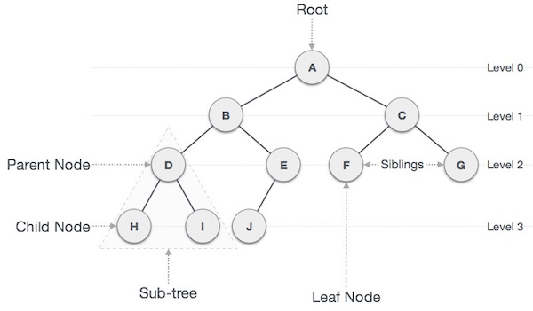
Tree
Is one data structure.
its principal characteristic is that it store data in a hierarchical structure.
To navigate through it we use recursive functions.

Slide 3
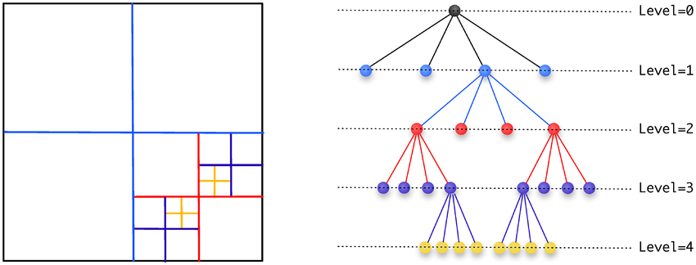
QuadTree
Quadtree is a type of tree in which a parent node has four child.
Uses:
Camera Culling.
Check Collisions.

Slide 4
Why we use QuadTree?

Slide 5
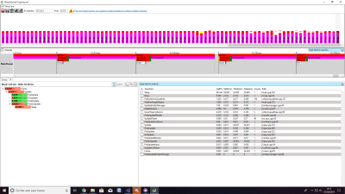
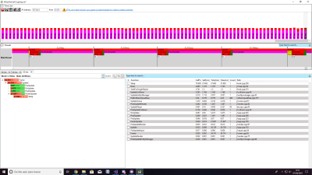
Brofiler - 15 entities
Quadtree
development method

Slide 6
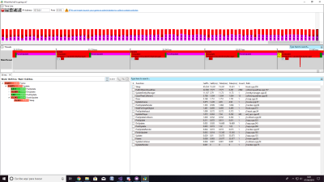
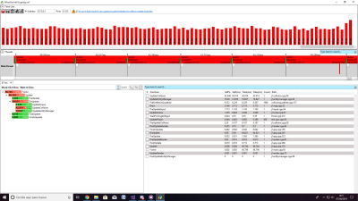
Brofiler - 300 entities
quadtree
Development method

Slide 7
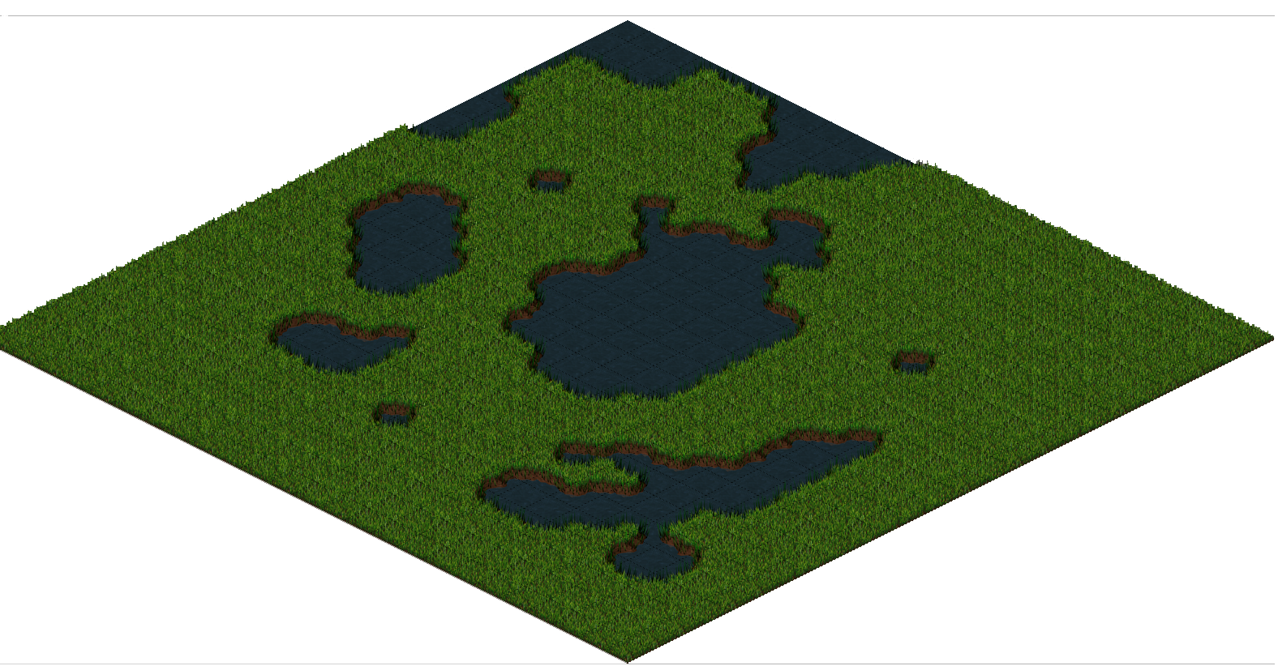
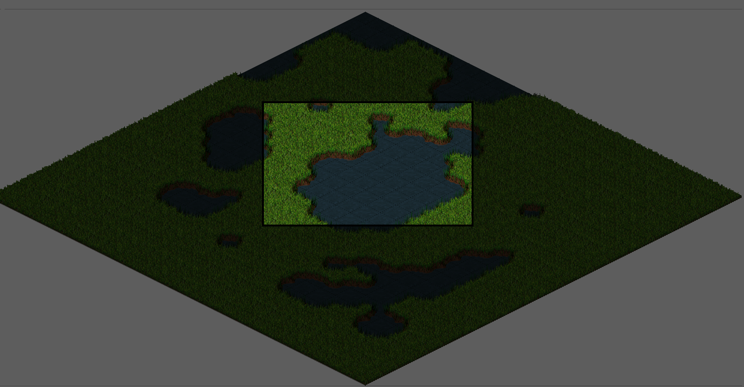
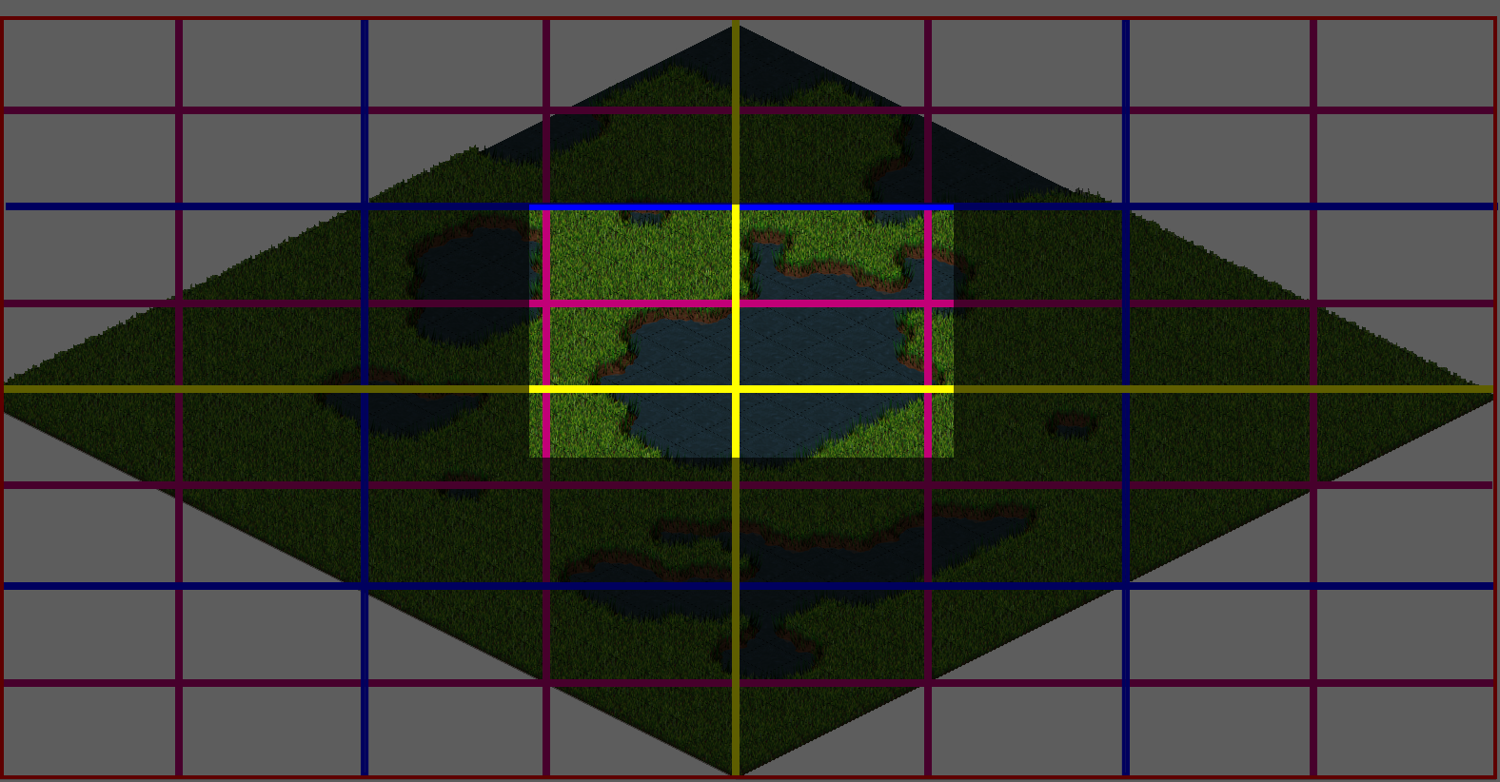
Camera Culling
Static QuadTree.
Check if the node rectangle’s area is inside the camera.

Slide 8
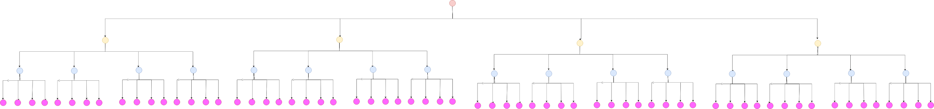

Slide 9
Check Collisions
Dinamic quadtree
Entity tells the QuadTree where the node is placed
Check collisions with entities that are in the same node

Slide 10
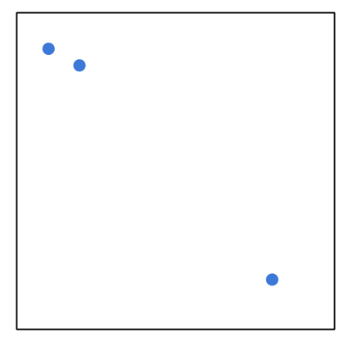
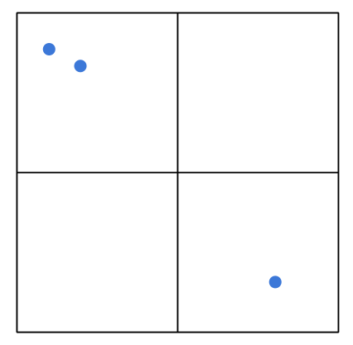
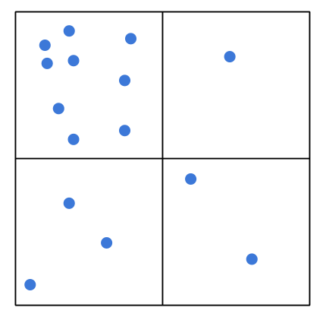
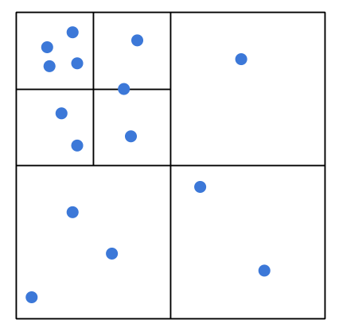

Slide 11
TODOS:

Slide 12

TODO 1:
Implement AddCollider function();
This function only adds colliders in the tree’s level where it’s called.
If the size of the Elements list is smaller than maxElements call subdivide function.

Slide 13
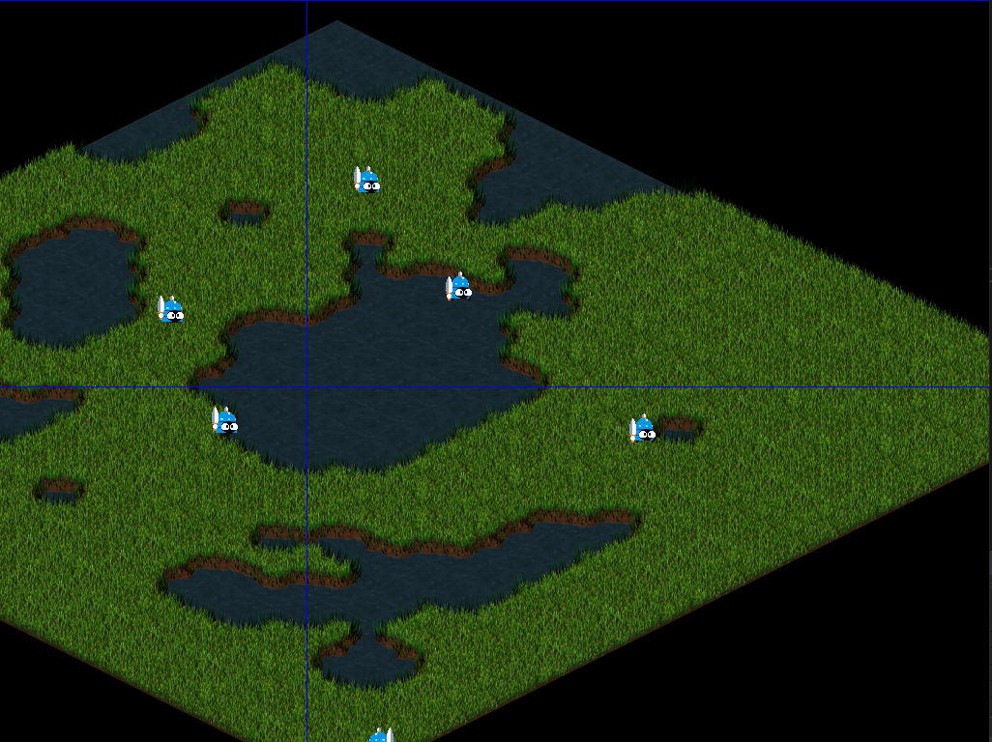
TODO 2:
Implement Subdivide function.
Create 4 childs that are divisions of the father.

Slide 14
TODO 3:
Create the loop which distributes the colliders between the 4 new quadtrees
Remember to delete colliders when saved in a subnode
Call this function in subdivide

Slide 15
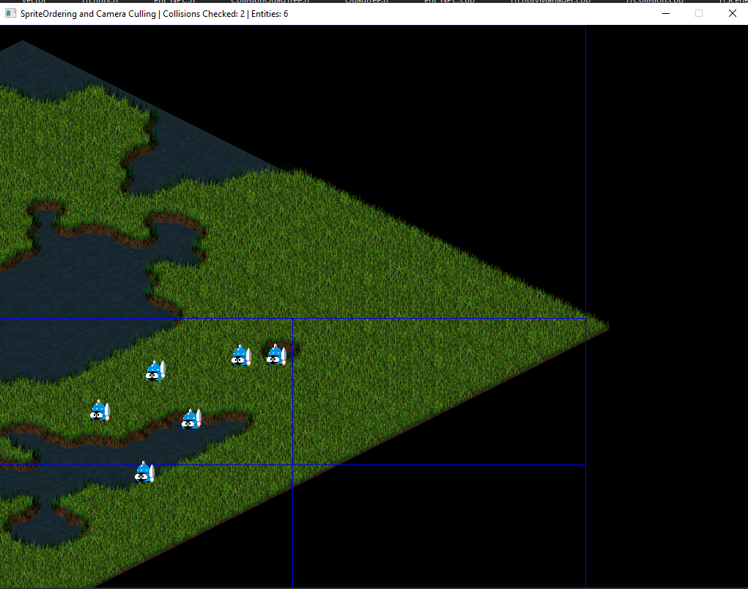
TODO 4:
In the function implemented in TODO 3 creates the condicion to call subdivide function.

Slide 16
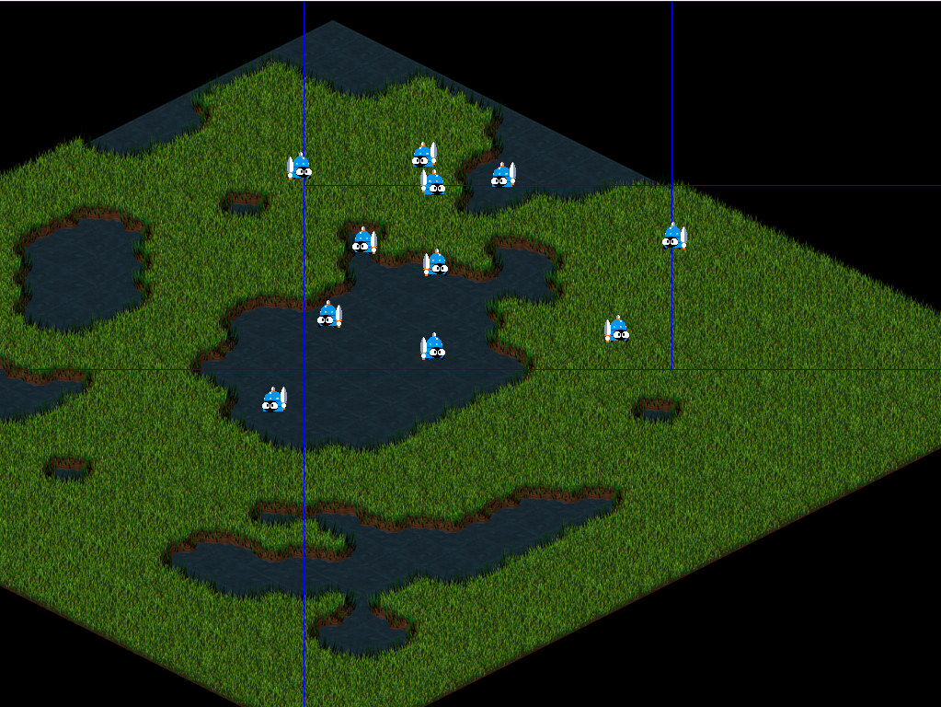
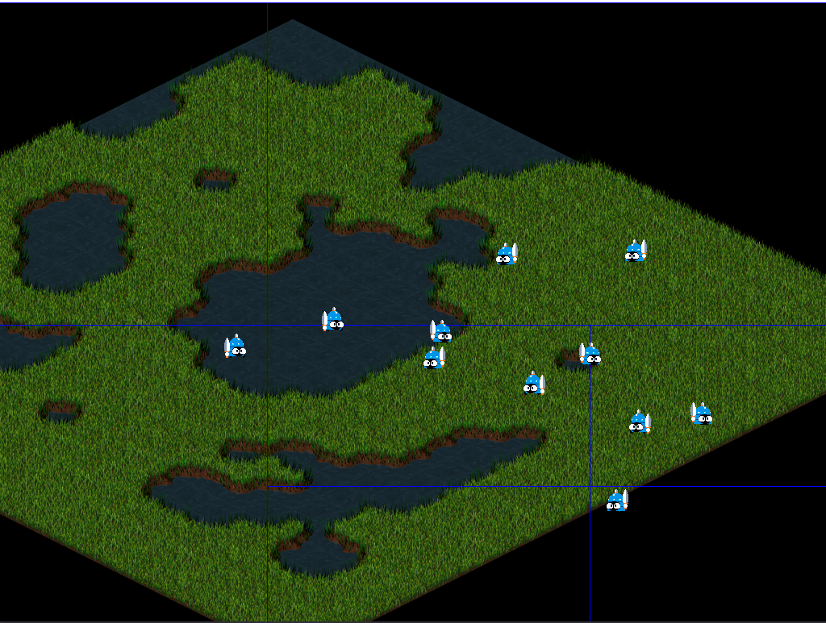
TODO 5
implements the method that puts a collider in its place in the quadTree
uncomment the commented parts. It also implements the function when is divided
Uncomment function in Scene.cpp

Slide 17

Especial case
What happens when one of entities is over to one line?
In this case save the collider at the topmost level which belongs
Check TODO 5 and make sure that this successful.

Slide 18
TODO 6
Take the function that checks collisions in the same level and implement it to check the collision with its childs.

Slide 19
Thanks!
mail: dllop.9@gmail.com
github: didaclis

